Slide 1
Welcome to My Presentation On
Industrial Attachment Training
Course code: CSE311

Slide 2
Presented By:
Israt Jahan Reshma
Id: 18ICTCSE041
Department of CSE, BSMRSTU

Slide 3
Under the guidance of:
Marajul Islam
Associate Software Engineer,
Enosis solutions

Slide 4
Training On
“Software Development and Working Environment of a Software Development Company”
–Under Engineering Department of Enosis Solution

Slide 5
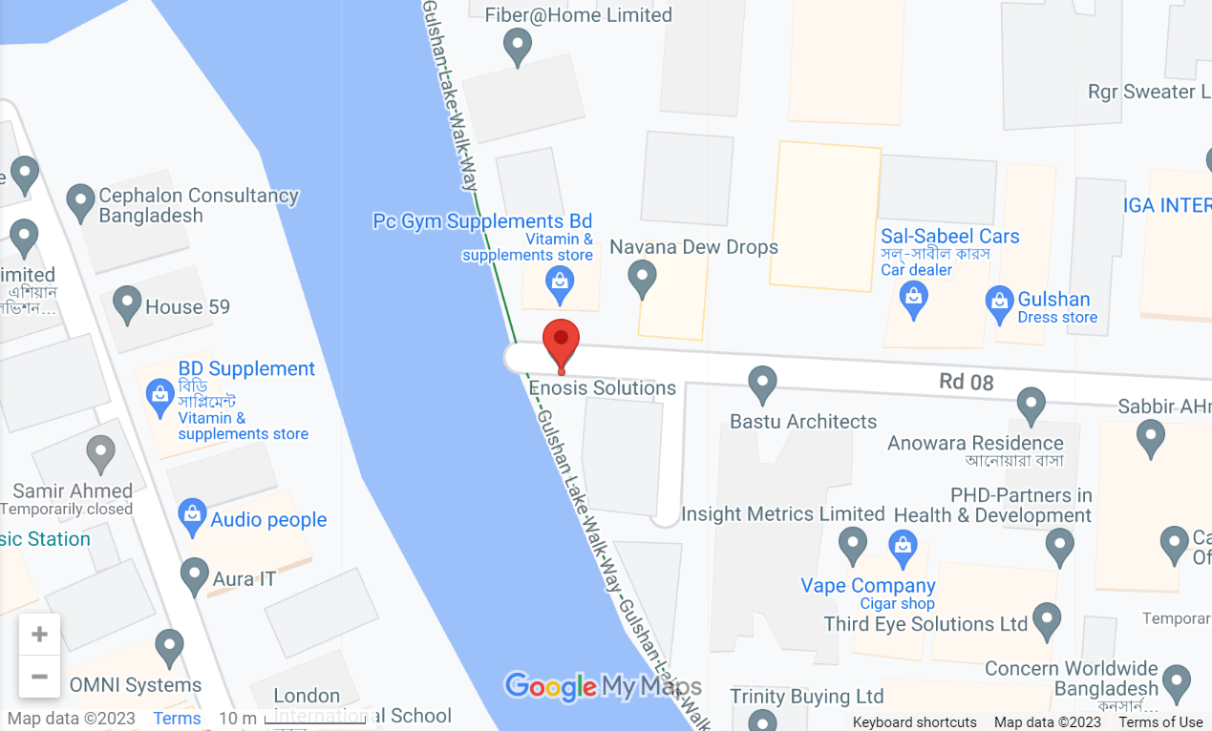
Visited Company
Enosis Solutions
House 27,Road 8, Gulshan 1, Dhaka, Bangladesh.

Slide 6
About Enosis Solutions
Enosis is a leading software company.
Establishment year: 2003
CEO: Jishan Shah.
Software development and testing services provider.
Having talented software engineers, develop web, desktop, and mobile applications for their clients.
About 500 people are working here and about 400 out of them are engineer.
Most of clients are from North America and Canada.

Slide 7
Departments of Enosis Solution:
Accounting
Admin
Engineering
HR
IT
Sales and Marketing

Slide 8
Services of Enosis Solutions
Custom Software development
Web Application Development (Most used – about 60% over the world)
Android Application Development(Application layer is android and internal layer is web)
Quality Assurance and Testing

Slide 9
Some of their Clients:
Matrix
IQ-3
Smarter-Services
INFO Net
Power House Dynamics

Slide 10
What we have learn from this Training:
Order getting process
Requirements and risk analysis
Distribution process of a project
Develop the project and handling problems during development
Software testing and debugging
Deliver to clients

Slide 11
Order Getting Process
Website
Email
LinkedIn Marketplace
From fiver
Upwork
Previous Clients

Slide 12

Requirements and Risk Analysis
Analysis the requirement
Determine the possible risk and how to overcome them

Slide 13
Process Distribution Distribution
Developer
Frontend
Backend
DevOps
Project Manager
Team Lead
Developer
QA Team
Client Review

Slide 14
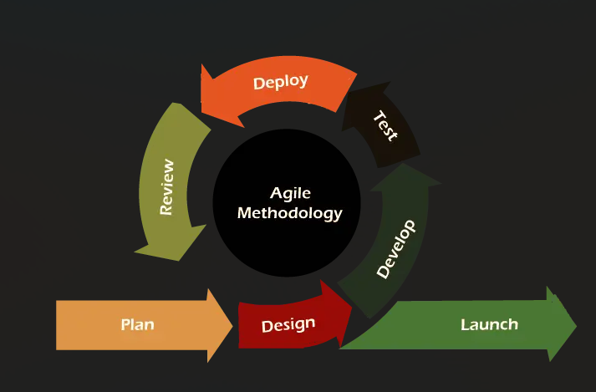
Following Process Model: Agile Model

Slide 15

Development & Problem Handling
Discuss with team leaders
Choose the best approach

Slide 16
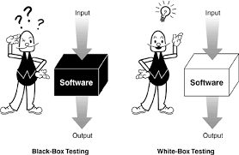
Software Testing
Testing
White Box Testing
Black Box Testing
By developer
By QA Engineer

Slide 17

Deliver to Clients
Finally, a successful project will deliver to clients.

Slide 18
Thanks to All

